Slide 1
Car Plate Number Detector
Sanjana Panda

Slide 2
Problem
In the day and age of images all around, one CV problem is recognising text from images.
Aim: Is to recognise car plate number from images.
Data: Data was collected from Kaggle. 430 images of cars are collected.
Process: Step 1: Detecting car plate. Step 2: Number Recognising.

Slide 3
Project Architecture
Input Data – Images and Annotations
Object Detection
Generate the TFRecord
Train the model – ‘ssd_mobilenet_v2_fpnlite_640x640’
Export the model
Text Recognition
Crop Image
Clean Images
Perform binarization using OCRopus
Recognise Character using Tesseract
Output Pre-processing
Output Data

Slide 4
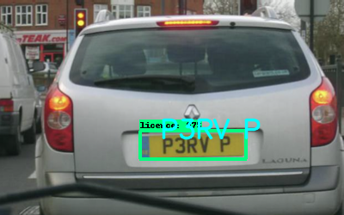
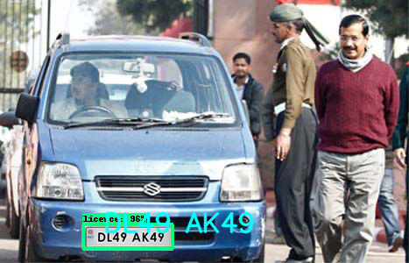
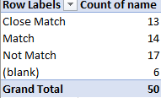
Result
Object Detection
mAP: 0.493867
mAP@0.50 : 0.952
Text Recognition

Slide 5
Future Improvement
The threshold is set higher i.e. 0.6 because even if plates are detected. Because with lower threshold, images detected are highly pixelated.
Some characters are getting jumbled e.g. '8' and 'B’.
Many a times images or interference within the plates, don't help getting results.
Adding rules to preprocessing extracted texts for images.

